Slide 1
Coin-Flipping Game
Julia Ruiz, Tristan Waddell, Melissa Tang, Xinyi Wang

Slide 2
State and Optimization
f(s,t) represents the probability that you win the game
s = score
t = turns left
If there are zero turns left and the score is less than or equal to 0 you lose...
If there are zero turns left and the score is greater than or equal to 1 you win!
We are trying to optimize the probability of winning

Slide 3
Excel Algorithm
Created 144 rows to represent 144 turns and set the values in the columns to include numbers ranging from -100 to 100. The columns represent the score.
Hardcoded the really small scores and set them to “0” and set the really big scores to “1”
Calculates the probability of winning when flipping the dime and flipping the quarter
Dime:0.5*f(s-1,t-1) + 0.5*f(s+1,t-1)
Quarter:0.5*f(s-2,t-1) + 0.5*f(s+2,t-1)
H
T
H
T

Slide 4
Excel Algorithm (Cont.)
Compares the probability and choose the better score
f(s,t) = max{0.5*f(s-1,t-1) + 0.5*f(s+1,t-1), 0.5*f(s-2,t-1) + 0.5*f(s+2,t-1)}
If the probability of flipping the dime and the quarter are 0 and 1, set it to Game Over
If the probability for flipping the quarter is the better score set it to Quarter
If the probability for flipping the dime is the better score set it to Dime

Slide 5
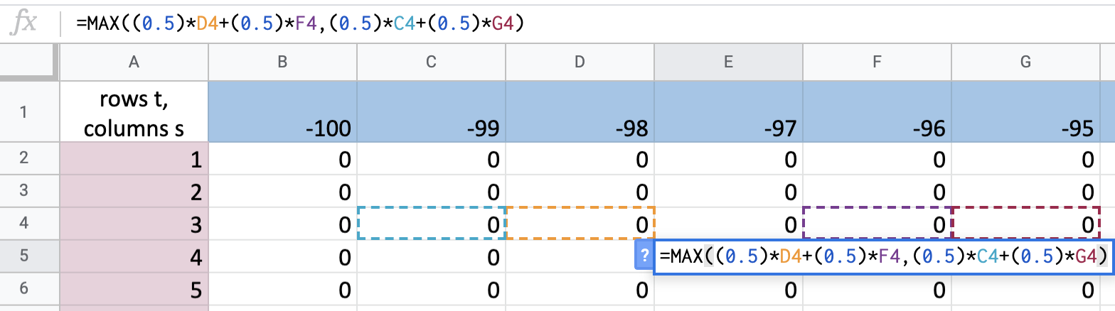
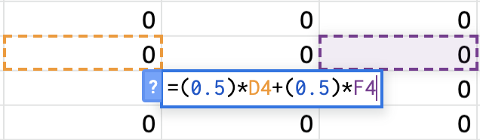
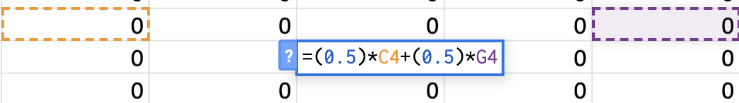
COMBINED PROBABILITY
DIME PROBABILITY
QUARTER PROBABILITY
accounts for increase or decrease of 2 points
accounts for increase or decrease of 1 point

Slide 6
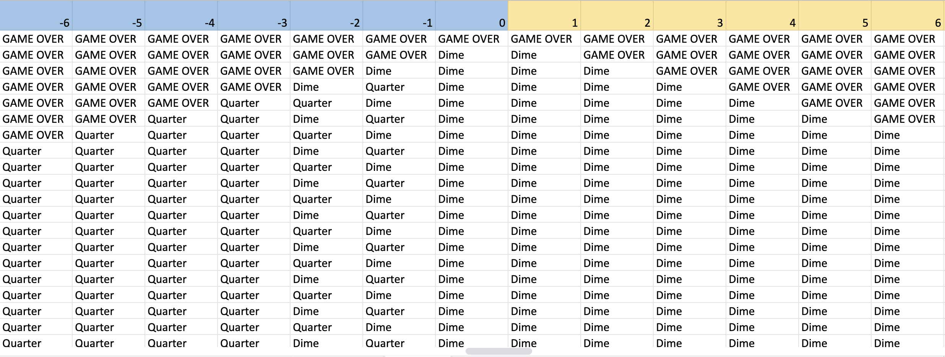
Deciding to Flip Dime or Quarter
Take whichever coin has a higher winning probability
Mostly Dime
Mostly Quarter

Slide 7
Final Conclusion
We found that:
-when the user’s score is positive and the turns are closer to zero, they should flip dime to maximize their chances of winning
-when the user’s score is closer to zero and the turns are relatively high, they should flip quarter to maximize their chances of winning

